Slide 1
Secure Data Hiding in Image Using Steganography
CAPSTONE PROJECT
Presented By: KREENA BATAVIA
Student Name : KREENA BATAVIA
College Name & Department : V.V.P Engineering College , Computer Engineering Department

Slide 2
OUTLINE
Problem Statement
Technology used
Wow factor
End users
Result
Conclusion
Git-hub Link
Future scope

Slide 3
Problem Statement
In an era of increasing cyber threats, protecting sensitive information during digital communication is a major challenge. Traditional encryption methods can alert attackers to the presence of confidential data, making steganography a preferable alternative. This project aims to develop a secure and efficient technique for embedding and extracting hidden messages within images without noticeable distortion. The proposed method will ensure confidentiality, integrity, and undetectability, enhancing secure communication and data privacy in various applications.

Slide 4
Technology used
Libraries used in this project are – os , cv2, string , numpy and the platforms used are Python IDLE and VS Code

Slide 5
Wow factors
This project stands out by integrating multi-layer encryption with adaptive pixel encoding, ensuring both security and undetectability. It uses password-protected access and randomized pixel selection to prevent unauthorized decryption and detection. Unlike basic methods, it features automatic message length detection and lossless image quality preservation, making hidden data nearly impossible to trace. Additionally, it supports multiple image formats, making it highly secure, efficient, and practical for real-world applications like secure communication, digital watermarking, and forensic investigations.

Slide 6
End users
The end users of this steganography-based secure data hiding system include government and defense agencies for confidential communication and intelligence sharing, ensuring sensitive data remains protected from cyber threats. Journalists and whistleblowers can use it to securely transmit sensitive information without detection, maintaining privacy and anonymity. Corporate professionals and IT security experts benefit from safeguarding trade secrets and preventing unauthorized access to critical business data. Additionally, law enforcement and forensic investigators can utilize it to embed hidden information in digital evidence for secure storage and authentication. Even general users and privacy enthusiasts can leverage this technology for secure personal communication, ensuring their sensitive messages remain undetectable.

Slide 7
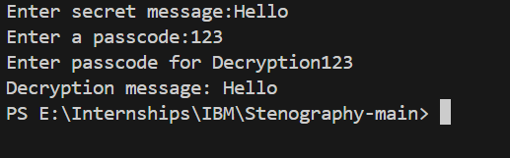
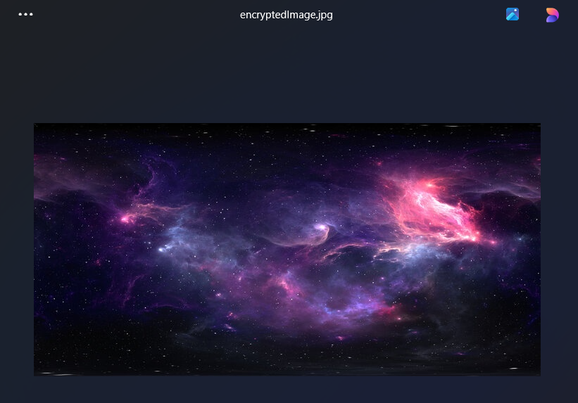
Results
Images of Output of stego.py file

Slide 8
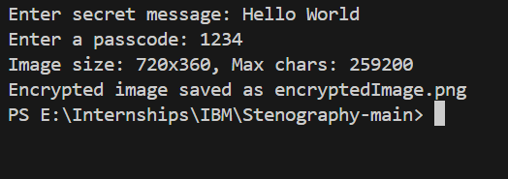
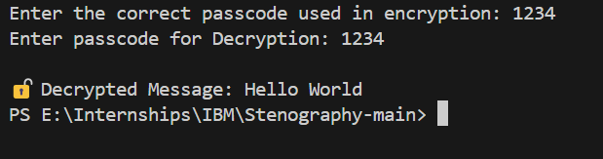
Image of output of encrypt.py file
Image of output of decrypt.py file

Slide 9
Conclusion
This project successfully addresses the challenge of secure data transmission by implementing an advanced steganography-based data hiding technique in images. By integrating multi-layer encryption, adaptive pixel encoding, and password-protected access, it ensures high security, confidentiality, and undetectability of hidden messages. Unlike traditional encryption, which can attract unwanted attention, this method seamlessly conceals sensitive information within images while maintaining their visual integrity. The system is efficient, reliable, and resistant to detection, making it highly applicable in secure communication, digital watermarking, and forensic investigations. Ultimately, this project provides a robust solution to modern cybersecurity challenges, ensuring safe and covert data transmission in various fields.

Slide 10
GitHub Link
https://github.com/KreenaBatavia/Secure-Data-Hiding-In-Images-Using-Steganography.git

Slide 11
THANK YOU

